Slide 1
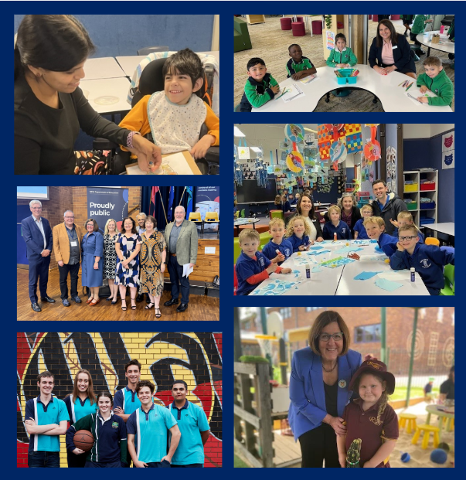
Institute of Retired Senior Educational Administrators AGM
21 March 2025
Excellence and Equity in NSW Public Education – Now and into the Future
Deb Summerhayes PSM
Deputy Secretary, Public Schools

Slide 2
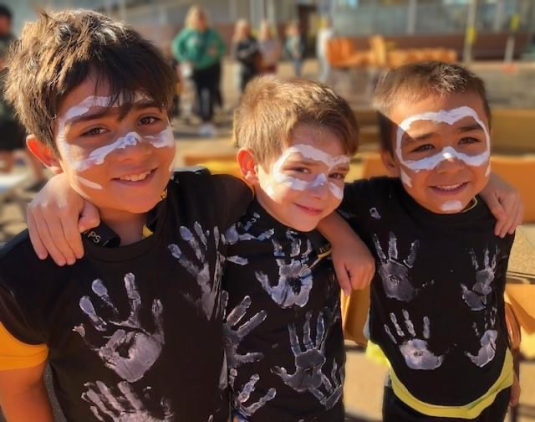
Acknowledgement of Country

Slide 3
Who we are in 2025
114 Networks
800K students
2,218 schools
110K school staff
9.5% Aboriginal students
0-252 school FOEI range
37% non-English language backgrounds
237 languages
Notes:
Who are we in 2025?
It's always good to stop and look at the numbers, to see the change.
In 2025, this is who we are:
Networks -114
Students – approx. 800k
Schools- 2218 (latest figures provided by Tim 18 March)
Staff – 110k
Aboriginal students – 9.5%
FOEI range – 0 - 252
Non-English language backgrounds – 37%
Languages - 237

Slide 4
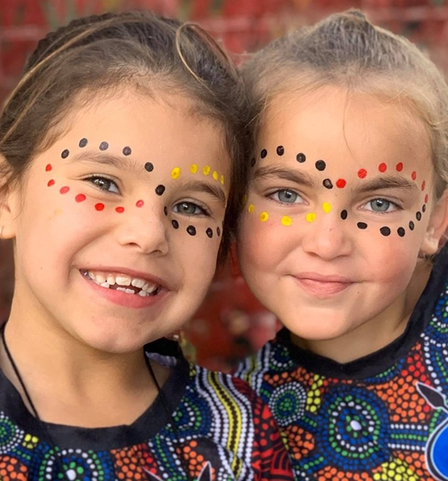
NSW public schools are for everyone
Schools reflect the diversity in our communities
1 in 11 students is an Aboriginal and/or Torres Strait Islander person
1 in 4 students is a person with disability
1 in 3 students has a language background other than English
1 in 4 students is learning in a regional, rural or remote area
1 in 4 students is learning English as an additional language or dialect
92% of the most disadvantaged schools in NSW are public schools​
278,000 children in NSW are currently living in poverty
Our diversity is our beauty.
How can we eliminate the barriers in our system that may prevent any student from reaching their potential?
Notes:
Let’s look beyond the numbers. Who are we, really?
Our schools are a reflection of our complex and diverse communities. This is the beauty of our system, but also one of our great challenges.
Our context is challenging with the most student need.
1in 11 is Aboriginal or Torres Strait Islander
1 in 4 is a person with disability
1 in 3 has a language background other than English
1 in 4 is in a regional, rural or remote area
1 in 4 is learning English as an additional language or dialect
1 in 4 government school students attend a school where half of the students are most disadvantaged. This is 3 in 100 for non-government schools.
92% of the most disadvantaged schools in NSW are public schools
278,000 children in NSW living in poverty
Additional statistics about poverty:
15.5% of children in NSW are currently living in poverty, that’s 278,000 children.
580,000 Adults grew up experiencing poverty frequently
Child poverty remains one of the most pressing and persistent challenges of our time, affecting one in six children in New South Wales. In some areas it is more than one in 3.
Poverty means not being able to afford essentials, such as food, transport and housing. As well as lack of financial resources, people living in poverty also experience a lack of stability, social connections and opportunities. For many families, poverty means not having the resources to provide children with a safe and thriving childhood
Poverty during childhood can have lifelong impacts. It can undermine a child’s future educational attainment, economic productivity, physical and mental health, and safety. Child poverty also creates barriers to opportunity and access, perpetuating a cycle of disadvantage that is difficult to break without targeted interventions.
Strength-based approach
Our diversity is our beauty.
Our schools are enriched precisely because of our differences
But the question we must all continually ask is: how can we eliminate the barriers in our system that may prevent any single student from reaching their potential?

Slide 5
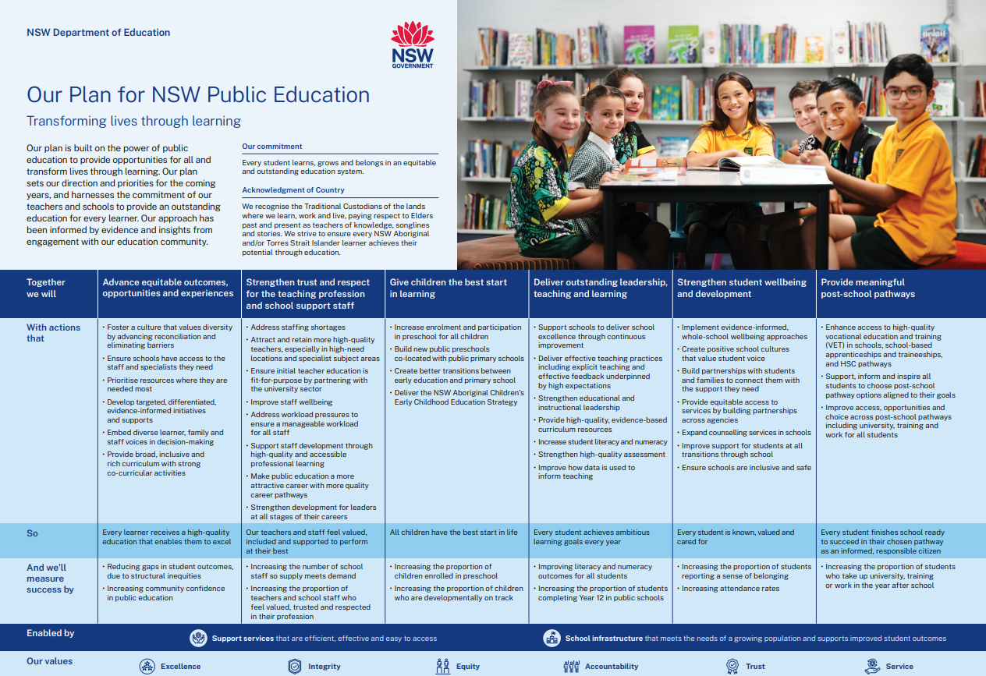
NSW Department of Education
Our Plan for NSW Public Education
Notes:
So what are we doing?
The words are here in Our Plan for NSW Public Education
Our commitment is that every student learns, grows and belongs in an equitable and outstanding education system.
I'll say those words again: Equitable and outstanding education system.
Everything in this plan is focused on equity and excellence.
And we cannot have excellence unless we have equity.

Slide 6
2024: Laying foundations
Teachers Consent Award
Temporary to permanent conversion
School Administration Improvement Program
Line-by-line reviews of policies and tasks impacting teachers
Enrolment growth audit
Vaping campaign
Religious intolerance and bullying helpline
Teacher vacancy reduction
Explicit Teaching statement and PL.
18 new and upgraded schools
Expanded priority recruitment
Expanded school counselling services
Mobile phone ban
100 new public preschools locations announced
Early childhood education fee relief
Additional support classes for students with disability
New curriculum resources and training
Our first Staff Wellbeing Strategy
Revised suspension and expulsion policy
Over 62,000 maintenance tasks at more than 1,400 schools.
Notes:
Our progress to date
2024 was about laying the foundations
This slide shows a snapshot of our work.
Every single square here contributes to a system that enables equity, whether it is:
Addressing staffing shortages
Embedding wellbeing policies
Or very specific actions, such as the mobile phone ban – these all help eliminate the barriers in our system that can prevent our students from reaching their full potential
But top down initiatives are not the only answer.
It's bigger than that.

Slide 7
Equity
Mindsets
Practices
Knowledge and skills
Leading equity for excellence
Equity is a capability that can be developed and deepened.
Notes:
Equity as a capability
To create equity, we need strong and courageous leadership across the system to enact a paradigm shift.
Gone are the days of a deficit model of responding to diversity, of ad hoc, case-by-case responses, of thinking of equity as an add-on.
The onus is on us to remove all the barriers that exist within our system to ensure every student can thrive
We must be universal by design
To do this, we need to reframe our thinking – we need to see equity as a capability that can be learned and developed – and we need to foster this in our staff.
Mindsets:
supporting equity requires our leaders to be stubbornly optimistic about the ability of education to transform every student’s life, whatever their background, ability, identity or circumstances.
Student-centred, courageous, curious, collaborative, growth oriented, efficacy – can help us to deepen our leading equity for excellence capabilities.
Practices:
We know what works best.
CESE’s What Works Best research shows how embedding high expectations practice and culture, supported by evidence-based teaching practices, creates optimal learning environments that support more equitable student engagement and achievement.
We know that explicit teaching is one of the key evidence-based quality teaching practices needed to transform these high expectations into a reality for students.
Knowledge and skills:
There is a myriad of skills and knowledge needed to support equity well.
In particular: being skilled in active listening, community engagement, reflecting on unconscious bias, challenging assumptions, and taking decisive action about discrimination, as required by the department’s newly launched Anti-Racism Strategy.
We need to champion why it is critical to seek a diversity of perspectives and voice, to deepen our collective understanding of people’s experiences of inequality and systemic barriers to achieving more equitable learning growth and achievement.

Slide 8
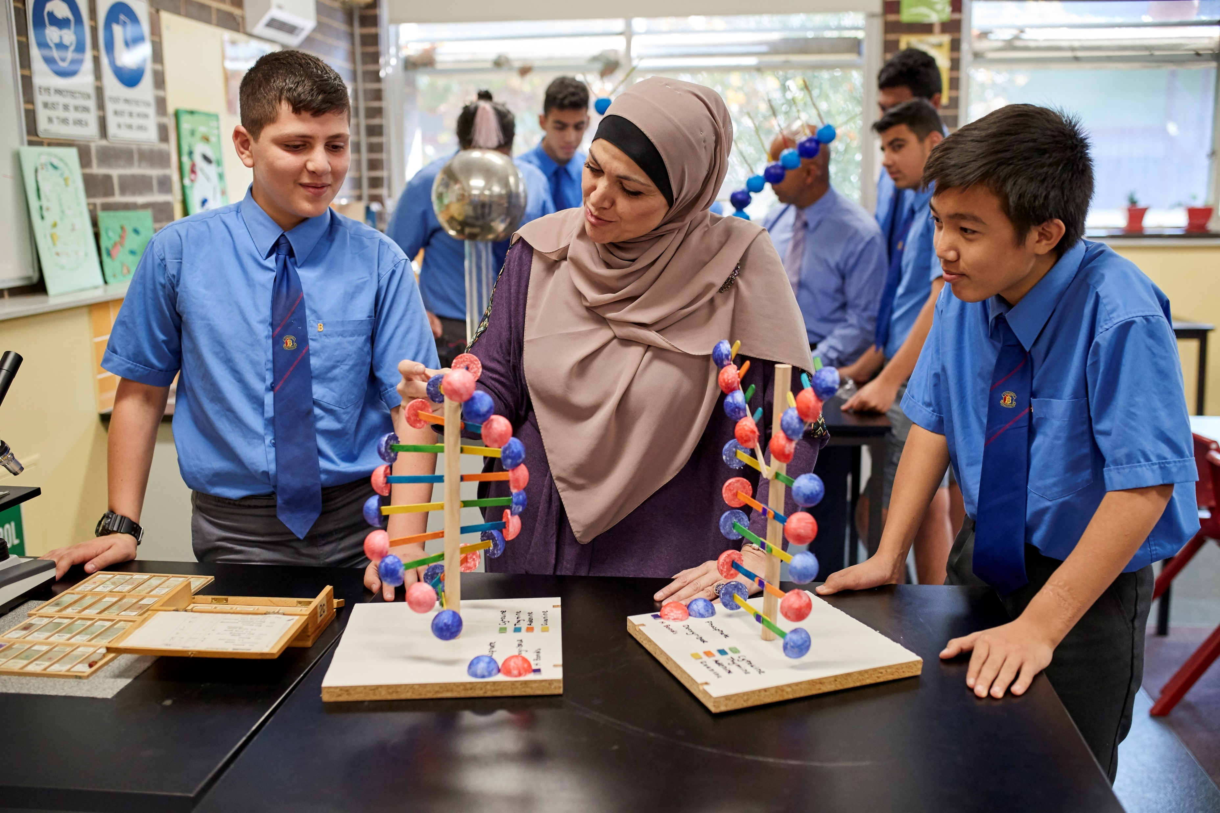
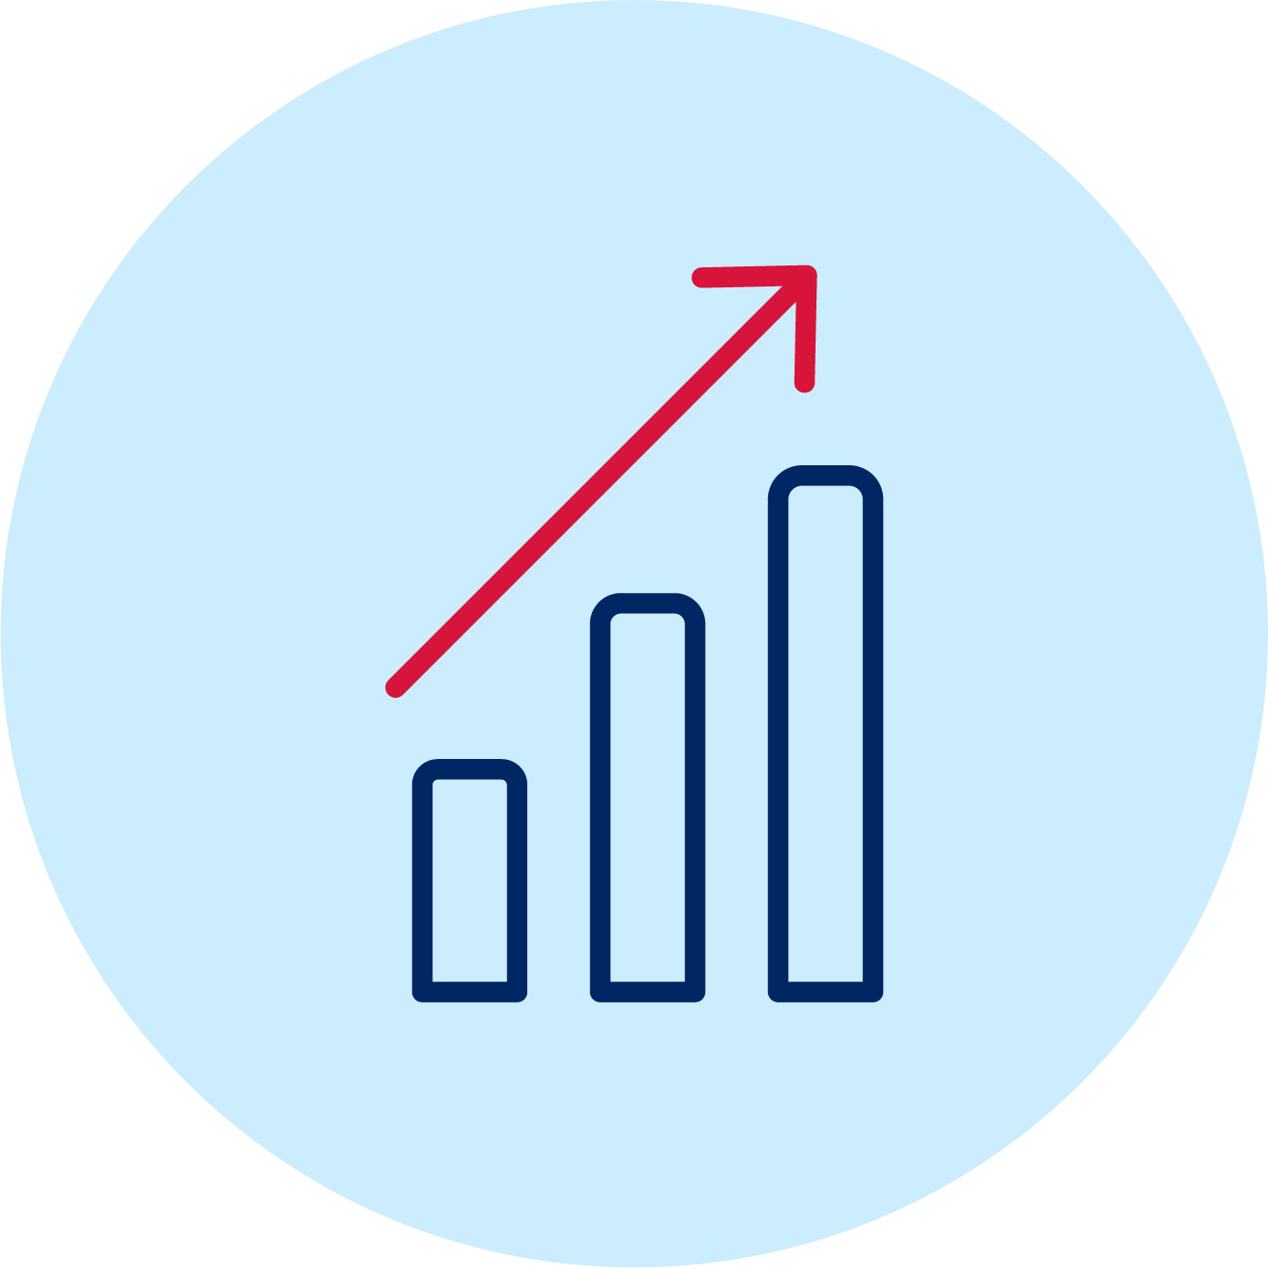
The way forward
Harness the equity capability of system, middle and school leaders to implement change.
Clarity in our thinking
Coherence of our goals
Consistency of practice
Notes:
The way forward - How do we harness this mindset, these practices, knowledge and skills to effectively implement change?
To do that, we need:
Clarity in our thinking:
Equity is complex and context dependent – There’s no Rosetta Stone.
Equity can mean many things to many people – the broad church of education means that we need to be deliberate, intentional and explicit about establishing a shared understanding and language for equity.
Conversations about equity can be difficult, but this is often a sign that you are doing it right.
It requires paradigm shifts for many of our staff and our leaders.
We are operating in an era of complex identities, of intersectionality, of the duality of inclusion and wellbeing, of high potential and gifted instead of the narrow lens of gifted and talented.
This isn’t easy for everyone, but equity must be our moral purpose – it matters deeply to people across our system. We need to make space for authentic conversations. This is how we broaden our empathetic imagination and get better at considering the perspective and experience of our students, families and diverse communities.
Conversations need to be ongoing because equity isn’t “set and forget”.
But we will get there, because we have clarity in our goals.
2. Coherence of our goals:
We have this.
Our Plan for NSW Public Education – all our work intersects to serve the single purpose of transforming lives through learning
We all know what needs to be done:
Our learning outcomes are clear
Explicit teaching is the way
We need to boost our enrolment share
We need to address attendance
We need to focus on every student
3. Consistency of practice:
We are well on our way with this
We have halved the number of our policies – from 361 to 182 by simplifying and streamlining them to support consistent application
And we are focusing hard on the ones that align to our plan.
HPGE is an excellent case study
The HPGE policy promotes engagement and challenge for every student in every school.
It identifies and addresses the learning needs of high potential and gifted students across 4 domains – intellectual, creative, social-emotional, and physical
The guiding principle of the policy is that all students, regardless of background or personal circumstances, have access to learning programs that meet their learning needs and support them to aspire to, and achieve, personal excellence.
This, too, is a critical piece of the equity puzzle

Slide 9
Enabling real shifts for equity and excellence
Find the balance between top-down and bottom-up direction
Enable conditions for networks of leaders to work towards these goals
Empower executive directors, directors and principals to lead from the middle so that efforts are:
Responsive
Nuanced
contextualised.
Notes:
Enabling real shifts for equity and excellence
Balance between top-down and bottom-up direction
Gone are the days of Local Schools, Local Decisions
Gone too are the ways of working based in “deliverology” – this was too prescriptive and failed to meet the different needs of different contexts
We are in a new realm. We have to be highly responsive, in keeping with the diversity of the community we serve
We must find the balance of trust and respect, of setting clear expectations and outcomes and holding our middle leaders accountable – but providing them with the conditions they need to do this in a way that fits their context.
This requires us to strengthen our networks and our communities of practice, to empower our middle leaders to lead from the middle, not just in the middle.
The difference here is crucial. We don’t want them to function as a layer of leadership. We want them to be the centre, to drive this change.
By leading from the centre, they can take initiative and carry collective responsibility.
They can be responsive and nuanced, appropriate to their context.
This is how we will build stronger communities and transform learning & wellbeing.

Slide 10
Our 2025 focus is
Equity
Our 2025 focus is
Explicit
Teaching
Our 2025 focus is
HPGE
Notes:
Next steps
All of this must be done in alignment with our plan.
This is the blueprint for all our actions, but as this slide demonstrates, our focal points for this year are clear.
Equity
HPGE
Explicit teaching
With our collective eye on these goals, and with strong leadership from the middle, we can make real progress

Slide 11
Notes:
Greenshoots

Slide 12
The joy of our work
Notes:
Peacock image: Hopetown SSP and principal Kirsty Fulcher

