Slide 1



Presentation to the Institute of Retired Senior Educational Administrators
IRSEA
30th of May 2024

Slide 2
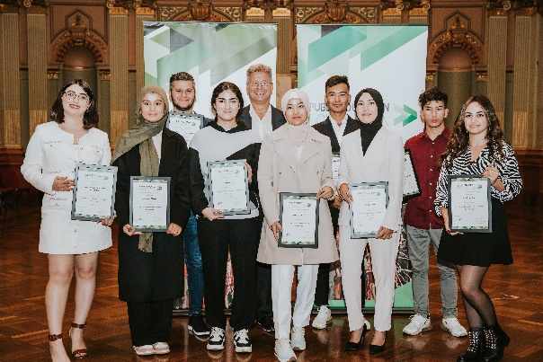
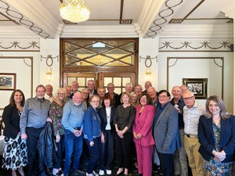
Public Education Foundation
Vision
a) Promoting and advocating a high quality, widely respected public education system
a) Identifying and supporting students who are experiencing financial and social disadvantage and identifying excellence in students and educators in the public education system.
Values
• Equity: Fairness and equitable access for all
• Respect: for people, internally and externally
• Sustainability: of our relationships and resources
• Opportunity: for individuals to fulfil their potential
IRSEA
IRSEA enriches the lives of retired senior educational administrators through engagement, collegiality, friendship and support while deploying its intellectual capacity and educational expertise for the betterment of public education in New South Wales and beyond.
Objectives
providing members with a forum for discussing educational issues
offering the benefits of the members’ experiences and wisdom to policy makers and senior officers in public education and to the wider community
contributing to the body of knowledge about the evolution of public education in New South Wales.

Slide 3
The Cycle of Disadvantage
.
Cycle of Disadvantage:
Public schools:
1
Low-income families
Deliver academic excellence
Embrace inclusivity, equality and diversity
Provide accessible opportunities
4
2
Poorer overall life outcomes
Poorer educational outcomes for children
Ensure value for money
Meet (or are close to) the School Resourcing Standard (SRS)
Enable higher education excellence
3
Have taught the majority of Australians
Difficulty getting a job

Slide 4
Our Solution
.
Laptops via WorkVentures
Online tutoring via Studiosity
Mentors
Scholarships
Scholarships for primary school students in public schools across Australia.
Scholarships for secondary school students in public schools across Australia.
Scholarships for secondary school students in public schools wishing to transition to study in TAFE or a public university.
Scholarships for teachers and principals.
Internet
PEF alumni access
Invitation to flagship event/s
Increased employment outcomes, and so much more.
Certificate of achievement etc.
.

Slide 5
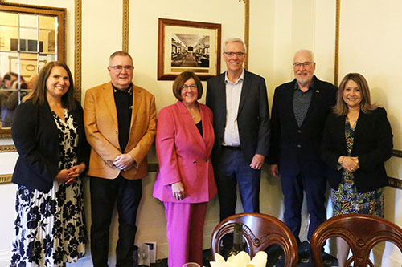
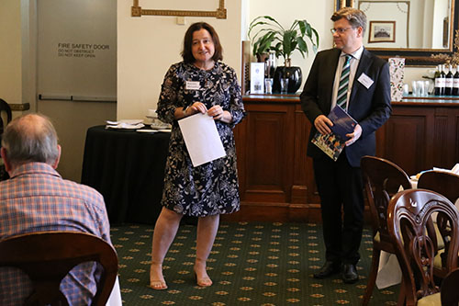
Who are our donors?
Some of our current donors
Teachers Mutual Bank
Teachers Health
Toyota
NSW Department of Education ( for scholarships for students in NSW only and for PEF work in NSW)
Corporate donors
Individual donors
AEU branches nationally
NSW TF
Pipeline of Potential Partners
Universities nationally
Every education department in all jurisdictions
Major corporations and industry across the nation.

Slide 6
Who Funds The Public Education Foundation ?
Trusts and Foundations 53%
Organisations and Partners 19%
Government 14%
Specific Scholarship Group 2%
Individuals 11%
Bequests 1%
2022/2023 Financial Year
The Public Education Foundation Trust supports a range of scholarships.

Slide 7
What do Scholarship Recipients Receive ?
Primary student scholarships.
$1,000 pa
Tertiary Scholarships.
Educators Scholarships
Principals Scholarships
Secondary student scholarships.
$1,000-$2,500pa
$2,000-$3,000 pa
Plus possible $3000 relocation allowance.
$10,000
Professional Development
$20,000
Harvard Leadership Program
An opportunity to change lives

Slide 8
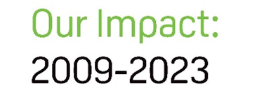
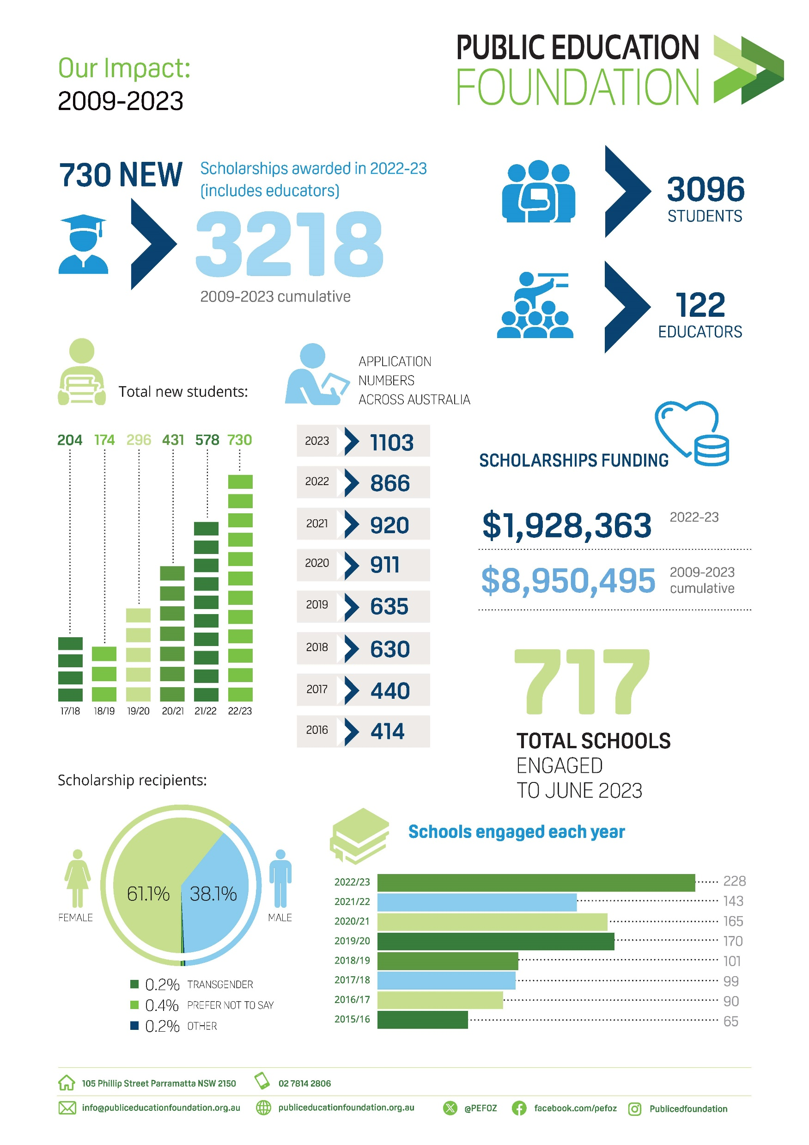


Slide 9
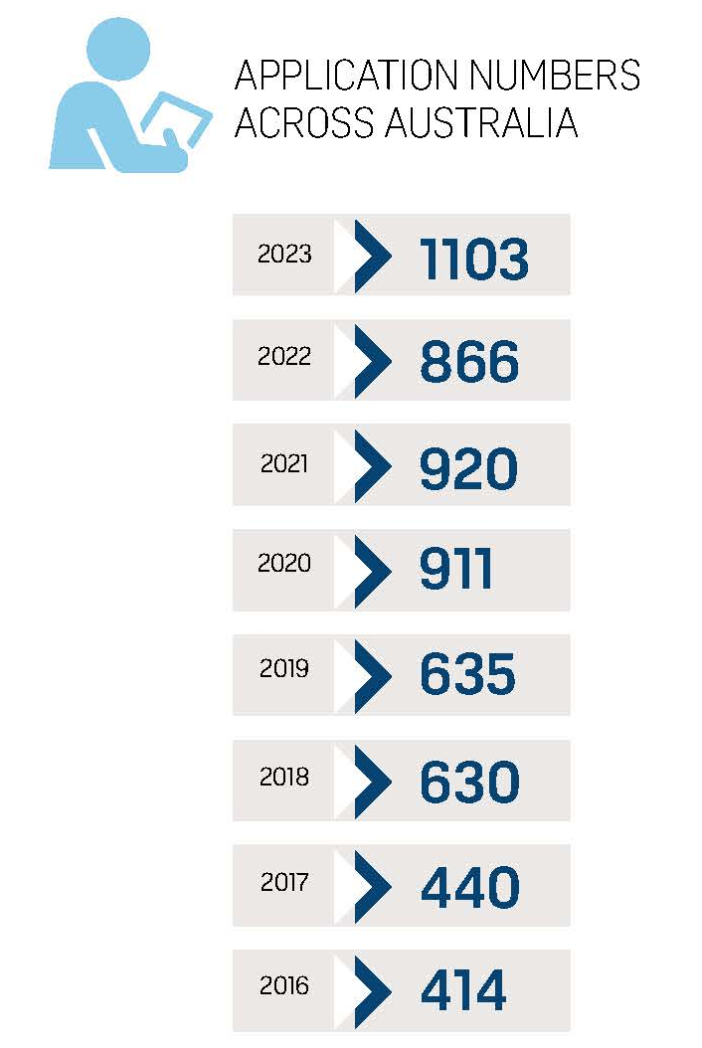
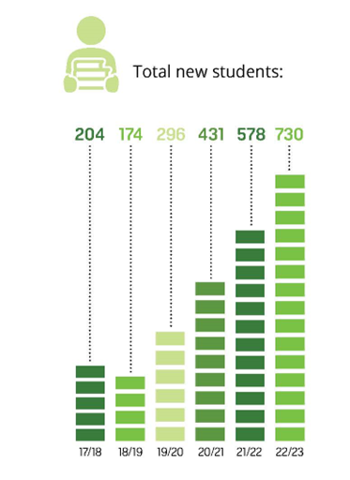

Slide 10
The Reality of PEF Scholarships for GWS
* NSW figures refer only to scholarships for which GWS students are eligible to apply.
We need more donors, sponsors, grants and government partners.

Slide 11
Scholarship Fund Usage
Laptop, iPad or similar device required for school or homework
Stationery and textbooks
Home Wi-Fi
Subject or study related software
Printer
School excursions and camps
Furniture for study, such as desk, chair or lamp
Face-to-face Tutoring or Online Tutoring
School subject costs
School uniform and shoes
Subject specific clothing eg: lab coats, chef whites etc
Tools specialised equipment required for coursework

Slide 12
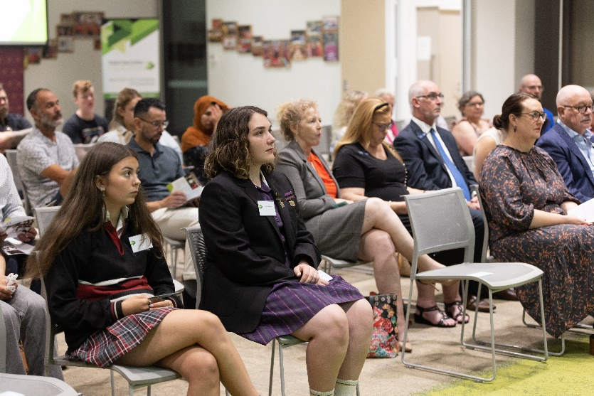
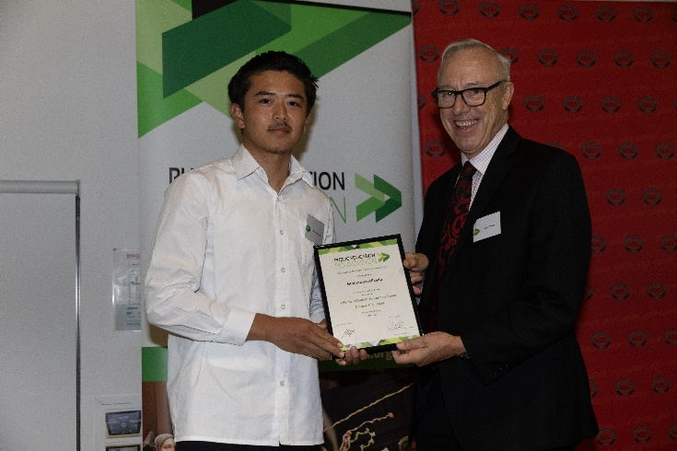
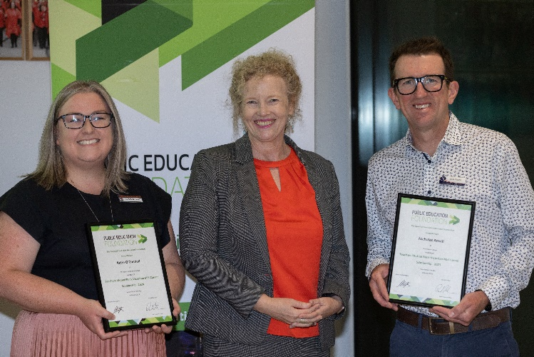
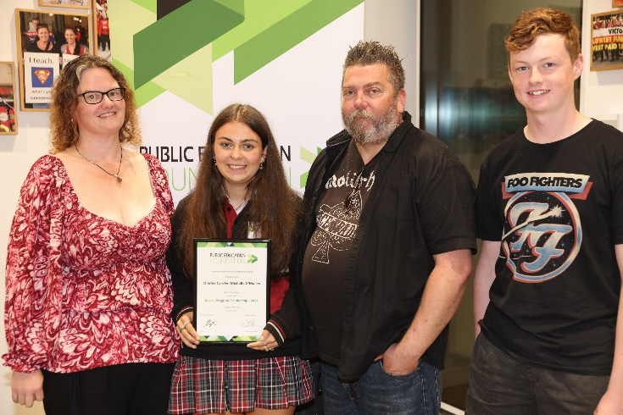
Recent Innovations
Scholarships for girls in public secondary schools to transition to TAFE or public university to study STEM courses.
Scholarships for teachers of STEM subjects in public schools to access professional development.
Tertiary scholarships for students in public schools to transition to teacher training at a public university.
Scholarships for students in public secondary schools in rural, regional and outer metropolitan areas.
The first Victorian Proudly Public Awards held in Melbourne in March 2024

Slide 13
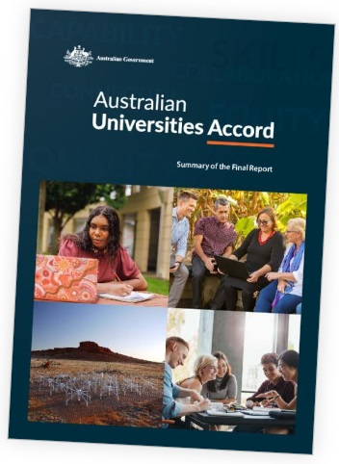
Universities Accord
Too few Australians are beginning and completing qualifications.
It is predicted that 90% of jobs created over the next five years will require a post-secondary qualification and 50% a higher qualification.
This combined with existing skills shortages means a sense of urgency for change is needed.
Setting and meeting more ambitious enrolment and equity targets will be crucial and will require a significant increase in the number of people enrolling in higher education.
The answer lies in large part in increasing the higher education participation of Australians from underrepresented groups – including First Nations people, lower socio-economic groups, people with disability and those from rural, remote and outer suburban communities.
To reach population parity, as much as 60% of this future enrolment increase in 2035 would need to come from these equity groups.
80% of students to have a post-secondary qualification (certificate 3 and above) by 2050.

Slide 14
Benefits of Partnering with PEF!
Public Education Foundation is an independent and responsive national body
Working to assist in addressing teacher shortages and increase teacher retention.
Strong national brand reputation
Impacting the lives of students, teachers and principals across the nation
Public education advocacy
Changing lives
A valuable contribution to the economy of the nation

Slide 15
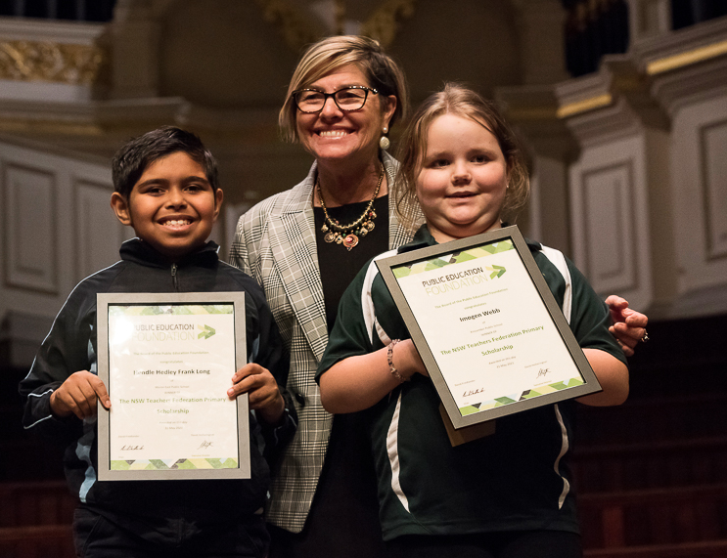
“I have always thought that one of the best ways that I could help other people is to open doorways for them to succeed.
To me, one of the best doorways that can be opened for a person is education because (under the right conditions) it can be a means through which a person can alter the trajectory of their life.”
A donor since 2016

Slide 16
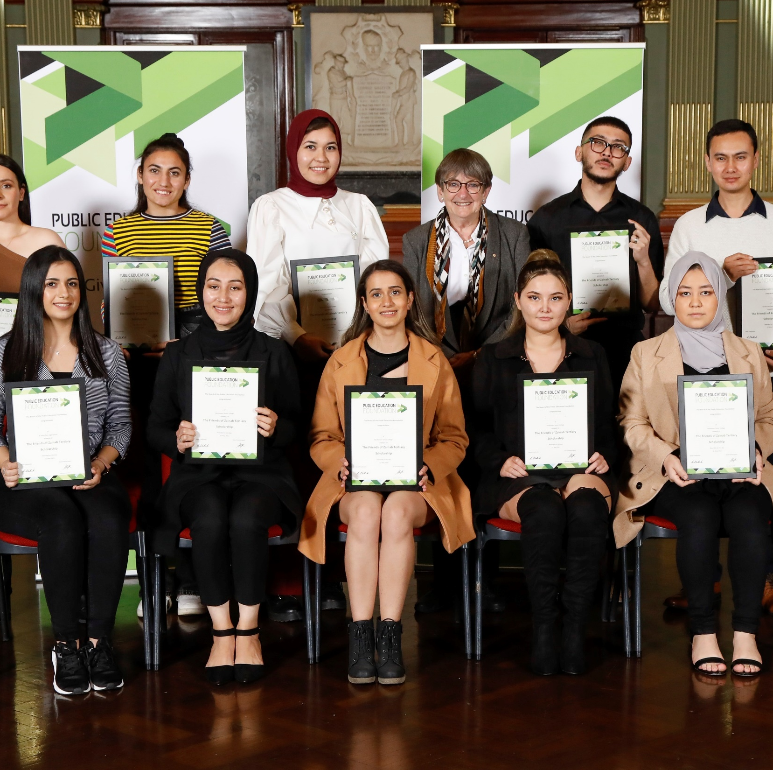
“Education is a way to give hope to students who have lost everything.”
Dorothy Hoddinott AO,
a retired principal

Slide 17
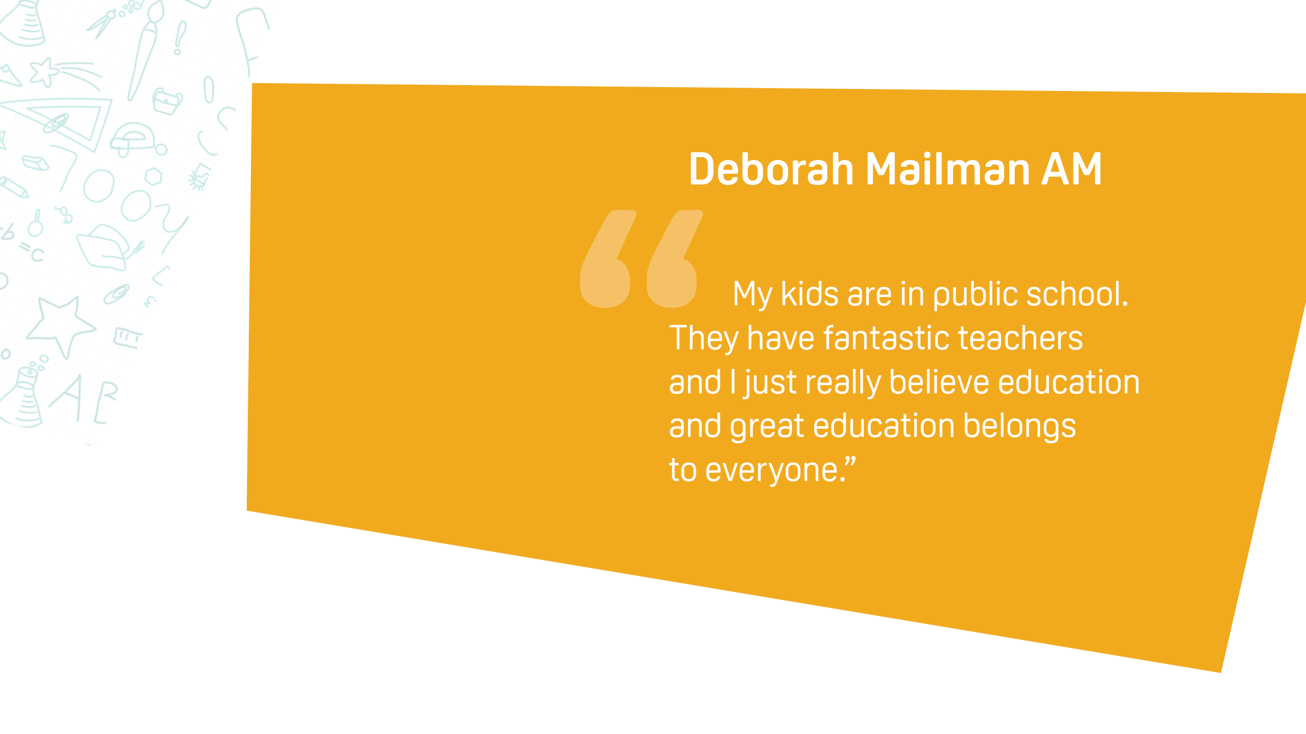
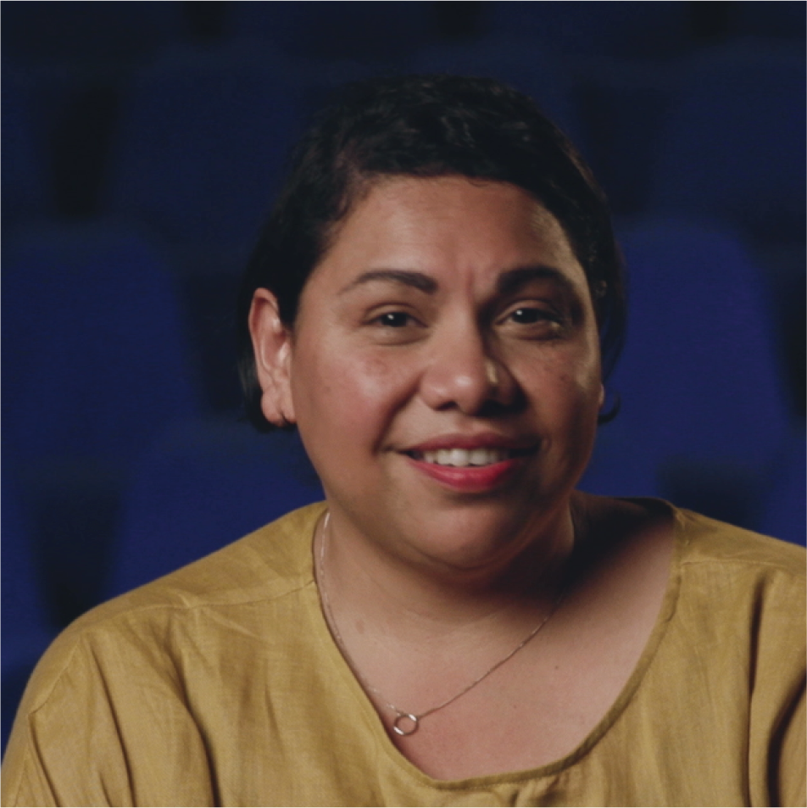

Slide 18
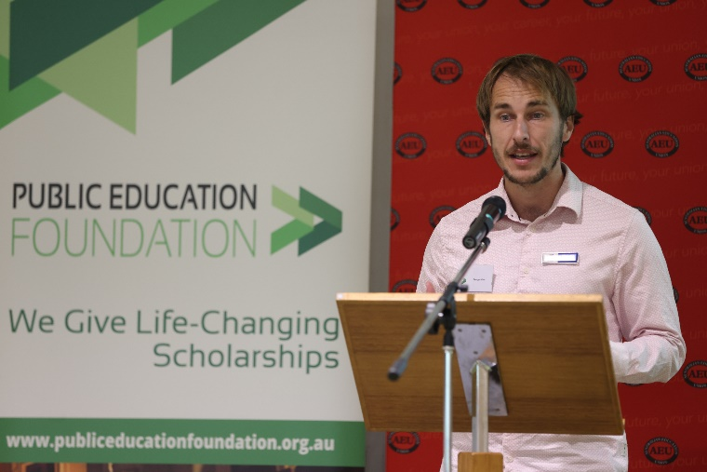
Thank you
https://youtu.be/HlzwQJV0cec

