Slide 1
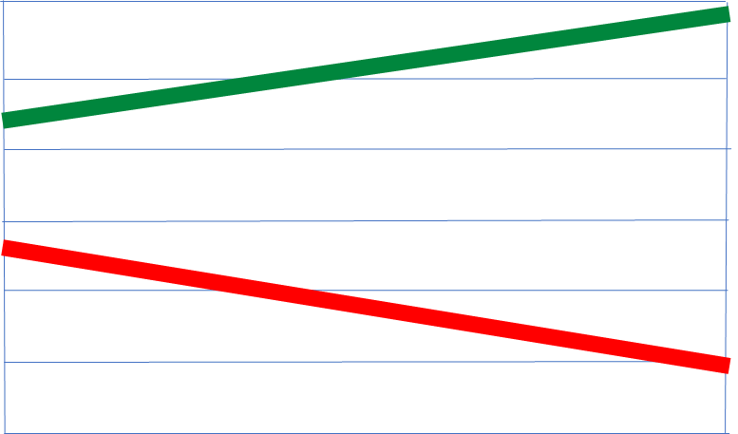
Institute of Retired Senior Educational Administrators
Public education in NSW: looking back and looking forward
Chris Bonnor, March 2023

Slide 2
The family income divide between
public and private secondary schools
Australia, 1986 to 2016.
2.0
1.8
1.6
1.4
1.2
1.0
0.8
0.7
0.6
0.4
0.2
0.0
Public schools
Ratio of low to high family income
Private schools
All Australian secondary schools
Source: Preston B (2018), ‘The social make-up of schools’
1986 1991 1996 2001 2006 2011 2016

Slide 3
Where are schools on the
SES (ICSEA) ladder? *
1150
1100
Within this range, schools with similar demographics get much the same public funding per student….and much the same student results.
Independent
1050
Catholic
SCHOOL ICSEA VALUE
1000
Government
950
900
* All Australian schools, ICSEA range of the middle 75% in each group.
Source: My School, 2018
850

Slide 4
What tends to happen to the scores of students who move up or down the school ladder?
AVERAGE
‘Q4’ STUDENT
AVERAGE
‘Q1’ STUDENT
AVERAGE
‘Q4’ SCHOOL
AVERAGE
‘Q1’ SCHOOL
ACHIEVEMENT SCORES
LOW SCHOOL ‘SES’ QUARTER HIGH

Slide 5
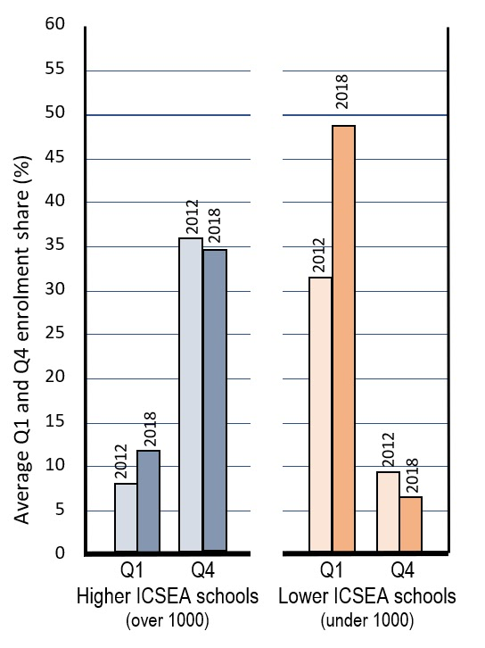
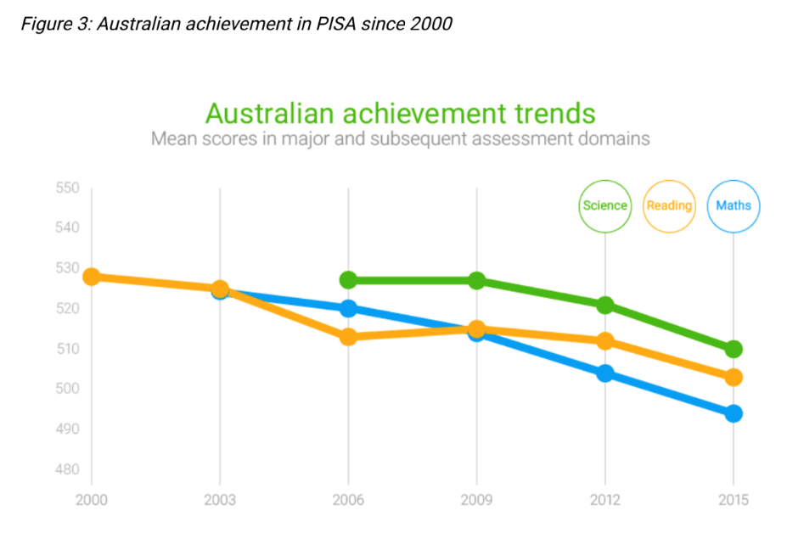
Changing enrolment in the ‘bottom’ SES half of schools,
2012 to 2018
Australian achievement trends
in PISA since 2000
50%
?
30%
They are getting more of the most disadvantaged …
… and fewer of the most advantaged
10%
By average Q1 and Q4 enrolment share.
All Australian schools
Source: My School 2012 and 2018.

Slide 6
60
55
50
45
40
35
30
25
20
15
10
5
0
Higher SES schools
Where have the HSC high achievers gone?
Lower SES schools
Percentage share of
NSW HSC Distinguished Achievers
2006
2021

