Slide 1
IRSEA Presentation: Changing nature of the School Performance Director Role Raechel McCarthy, Rel Director Office of the Deputy Secretary School Performance Mandy Shaw, Retired Director Public Schools Lake Illawarra Network and current Principal Coach Mentor
Notes:
Raechel to introduce herself and Mandy

Slide 2
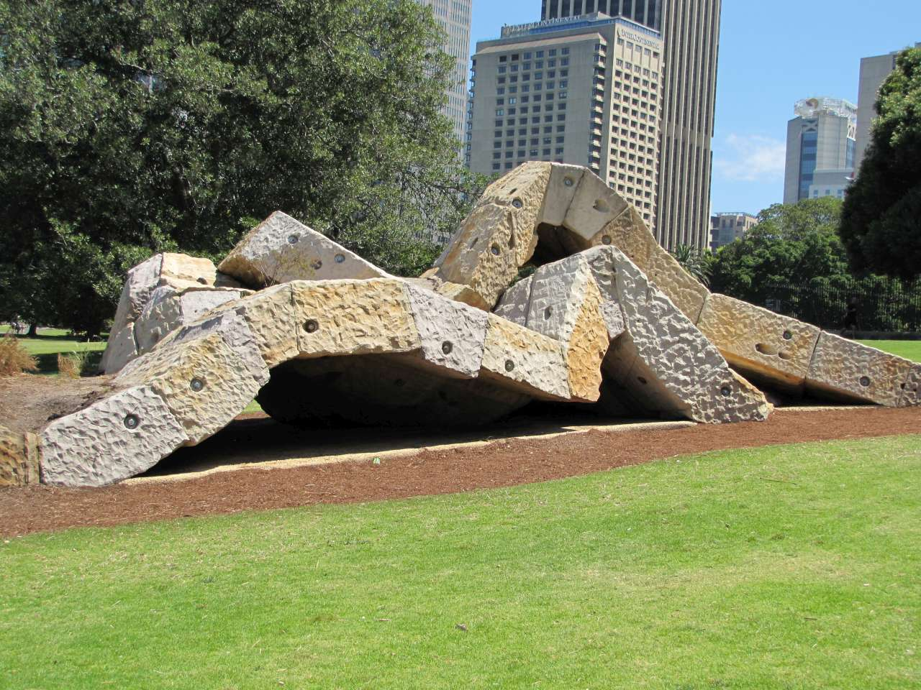
Acknowledgement of Country
Notes:
Raechel
Acknowledge the gadigal people and their deep connection to Warrane (the Gadigal name for Sydney Cove – Circular Quay). Royal Botanical gardens offers opportunity yo learn about the ways the plants in the Garden are used by the Gadigal.

Slide 3
Historical background to the new DEL role
New Director Educational Leadership role commenced in Term 2 2018
Massive investment in “the middle layer” of leadership doubling the number of directors (110)
All DELs required to attend extended induction over the course of 18 months (prior to commencing and during the first year in the DEL role)
Required to complete a Graduate Certificate in Instructional Leadership University of Melbourne
Mentoring by an experienced Director Public Schools
Notes:
Raechel

Slide 4
School Leadership Strategy
The School Leadership Strategy is a long term and ongoing strategic priority for public education in NSW. Its aim is to significantly enhance the department’s support for school leaders so they can focus on leading teaching and learning in their new schools.
The Strategy commits the department to three key actions:
1. Provide quality leadership preparation and development
3. Improve the quality of services and support to schools.
2. Strengthen collegial support for school leaders
Notes:
Raechel

Slide 5
School Leadership Strategy
Provide quality leadership preparation and development
i. Our own Leadership Institute
ii. Systemic induction and onboarding of new school leaders
iii. Scholarships for our best principals
Notes:
Raechel

Slide 6
School Leadership Strategy
2. Strengthen collegial support for school leaders
i. Directors, Educational Leadership
ii. A new principal role statement
iii. Principals, School Leadership
Notes:
Raechel

Slide 7
School Leadership Strategy
3. Improve the quality of services and support to schools
i. $50 million in flexible funding and interim staffing
entitlement adjustments
ii. Teacher performance improvement support
iii. Compliance inspection support
iv. Better coordinated, streamlined and aligned support
Notes:
Raechel

Slide 8
There are two key components of the DEL role
1.
Differentiated professional growth for principals
2.
Contextualised support for school improvement
Notes:
Raechel

Slide 9
Director Education Leadership
Network Planning
Support and Accountability
Stakeholder Management
Crisis Response
Change Management
Effective Reform Implementation
Notes:
Raechel

Slide 10
Expectations of the Director Educational Leadership Role
Build relationships with principals and their teams
Negotiate with principals a framework of support and professional learning
Develop communities of practice within and beyond the network
Build a collegial support network with other directors and PSLs
Notes:
Raechel

Slide 11
Expectations of the Director Educational Leadership Role
Establish relationships with key stakeholders eg, PPA/SPC Executive, AECG, Local Member
Seek advice and support from Executive Directors, Student Support and Specialist Program staff and colleagues
Visibility: Spend 70% of time in schools to develop a deep contextual knowledge of each school and become part of each school’s community
Notes:
Raechel

Slide 12
Support that Directors provide
Support and guidance for principals
Provide effective local leadership
An ally and partner for principals
A problem solver and sounding board
Support the principal on continuous school improvement
Develop professional relationships that are collegial, constructive, informed, insightful and focused on high expectations for every leader
Notes:
Raechel

Slide 13
Key Challenges
Building the capacity of principals to lead and manage in the context of local decision making and authority
Ensuring that high expectations of student and staff performance underpin all actions in schools
Developing a culture of evidence-based accountability at every level
Resolving contentious issues and disputes at a local level through consultation and mediation with principals, staff and other concerned parties
Notes:
Raechel

Slide 14
Key Relationships
A network of principals
Deputy Secretary, School Operations and Performance, Executive Directors School Performance and Directors Educational Leadership
Working relationships of the various educational divisions and understanding of their collective work to lift school performance
Notes:
Raechel

Slide 15
Key Relationships
Principals associations
NSW Teachers Federation
NSW Parents and Citizens Association
NSW Aboriginal Education Consultative Group
Key government agencies
Local Members
Key interest groups
Notes:
Raechel

Slide 16
Changes in the DEL role 2018 to 2022
2019 introduction of system negotiated targets for all schools
2020 Strategic Improvement Plans replaced School Plans. Greater emphasis on quality assuring plans ensuring strategies for school improvement are research based, informed by a systematic situational analysis and continually monitored and evaluated using implementation and progress monitoring
2021 introduction of universal, guided and strategic support for schools in meeting targets for improvement
Wide range of new SCOUT data sources to assist DELs and Principals
Impact of COVID and floods has also had an impact on the role
Notes:
Raechel

Slide 17
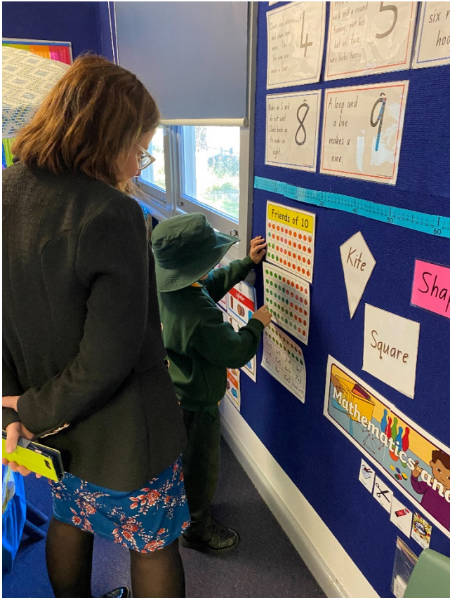
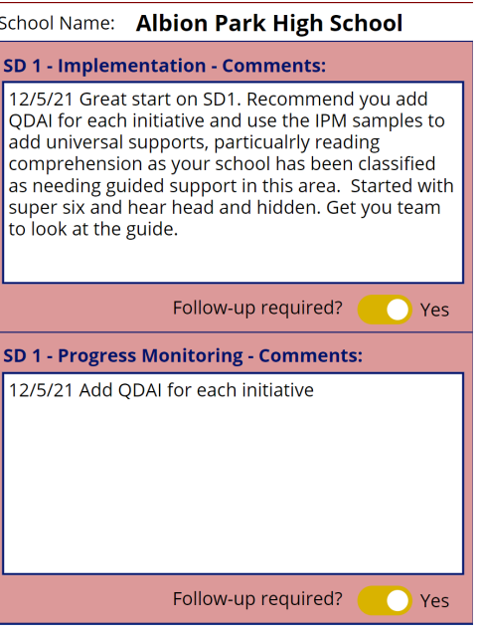
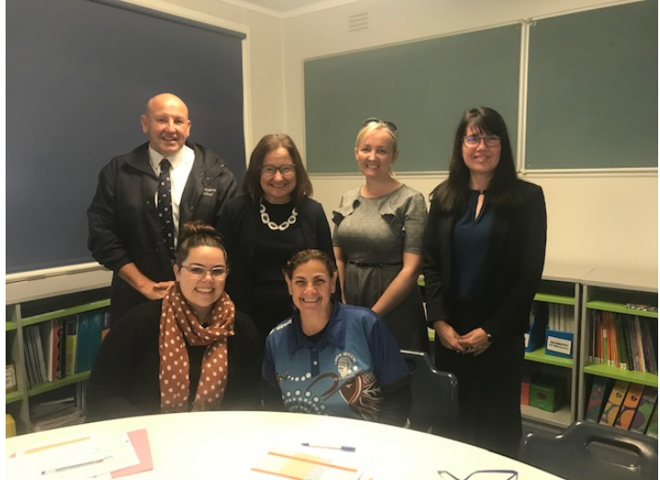
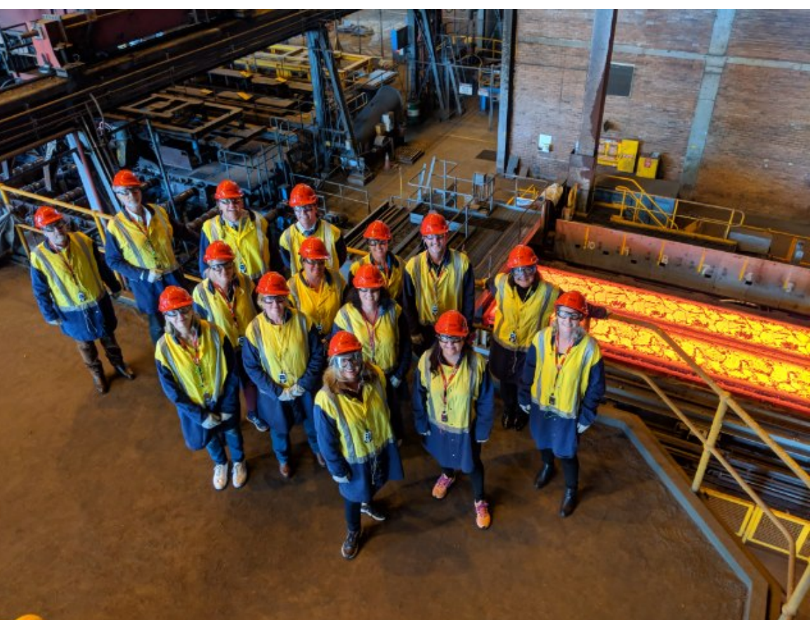
A picture tells a 1000 words!
Notes:
Raechel to unpack pictures then hand over to Mandy

Slide 18
DEL/Director Public Schools/SED: what is the difference?
Roles have many general similarities in terms of support and performance management of Principals in NSW public schools.
Main differences stem from recent technological advances and the halving of the number of schools overseen by Directors.
At the time of change from DPS to DEL there was a massive program of building new schools, most likely unprecedented in the number and scope of new builds. Many DELs across NSW were involved in multiple new school builds and held responsibilities for liaising with architects, planners, local council, builders from the moment a new school build was announced until the 2-3 year period when students and staff occupied the new school.
Notes:
MANDY

Slide 19
Director Public Schools | Director Educational Leadership
Approximately double the number of schools | 20 schools per network Closer working relationship Specific professional learning and induction for DELs (which did not exist for Directors PS)
School planning became more formalized and some use of data to identify schools for improvement eg; Bump It Up schools | School planning/targets for improvement based on Director access to more detailed school data analysis/evidence. School accreditation and its continued evolution. Far greater access to detailed school data than previously
Appointment of PSLs and their role supporting schools. | Sharper focus in work with PSL supporting schools and directors The review into the culture and operation of EPAC and subsequent change in name (PES) and focus
Notes:
MANDY

Slide 20
Director Public Schools | Director Educational Leadership
Complaints management responsibilities. | Changes to Complaints procedures and technology associated with recording and documenting complaints. Currently looking to take parent/carer complaints away from DELs to maximise their ability to focus on school improvement
Directors PS had less administration support than DELs. (.5) | DELs- 1.0 administration support
Portfolios across networks | No portfolios but more time to shape educational reform across the divisions through representation on governance groups
Notes:
MANDY

Slide 21
Has it worked?
DEL impact surveys across NSW largely positive
DELs were hugely important in our recent reponses to COVID and natural disasters such as fire and flood
NAPLAN results show some improvement
Achievement of targets has been difficult due to emerging issues. Pivot to looking at lift/growth from baseline
Ongoing challenge of support vs accountability and not becoming “the postman”
Notes:
Raechel and Mandy

Slide 22
Questions?

